Slide 1


RT-PCR and Genome Enrichment
ARTIC Network Train the Trainer - August 2022
ARTIC TRAIN 02AUG22
Rhys Izuagbe

Slide 2

Objectives
Define and outline genome enrichment
Outline the RT-PCR procedures used by the ARTIC nCOV pipeline
Introduce the next steps in the ARTIC nCOV pipeline – Solid Phase Reversible Immobilisation

Slide 3
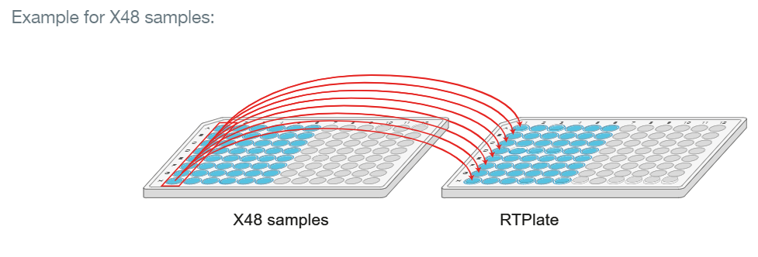
cDNA synthesis
Transcription of extracted RNA into cDNA
More stable for long term storage
Necessary first step for PCR-whole genome enrichment
Important to maintain control of samples throughout the entire process

Slide 4
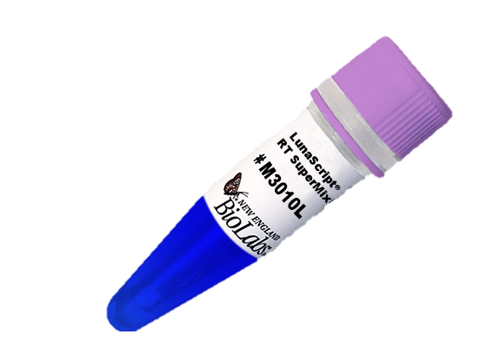
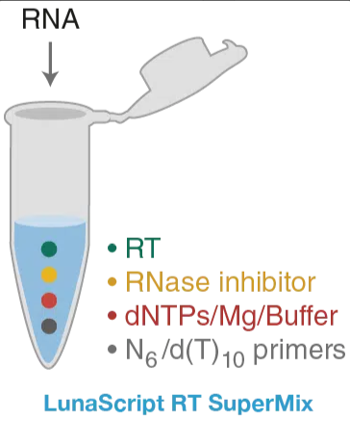
cDNA synthesis
You will need:
LunaScript RT SuperMix (NEB)
Sample RNA
CDNA synthesis requires < 15 minutes

Slide 5
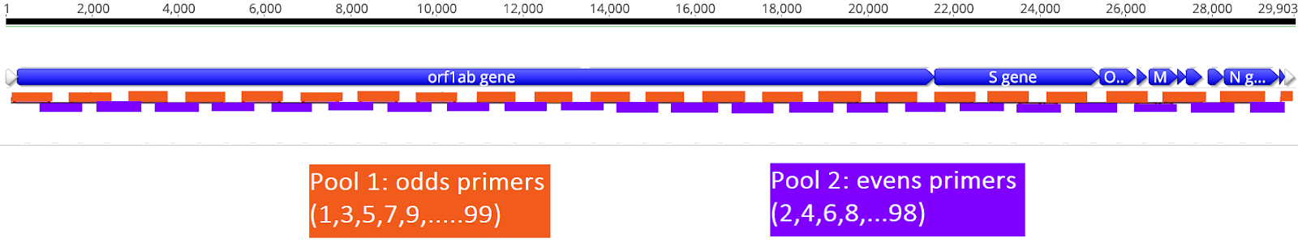
Amplicon based whole-genome enrichment
Amplification of cDNA covering the whole genome occurs in two reactions
Amplicons are designed to overlap each other, robust against mutations
Primer pairs are alternated between two pools, A & B
Avoids overlapping amplicons within a given pool producing aberrant products
Notes:
In total 99 primer pairs (400bp amplicon size) to cover the whole genome

Slide 6
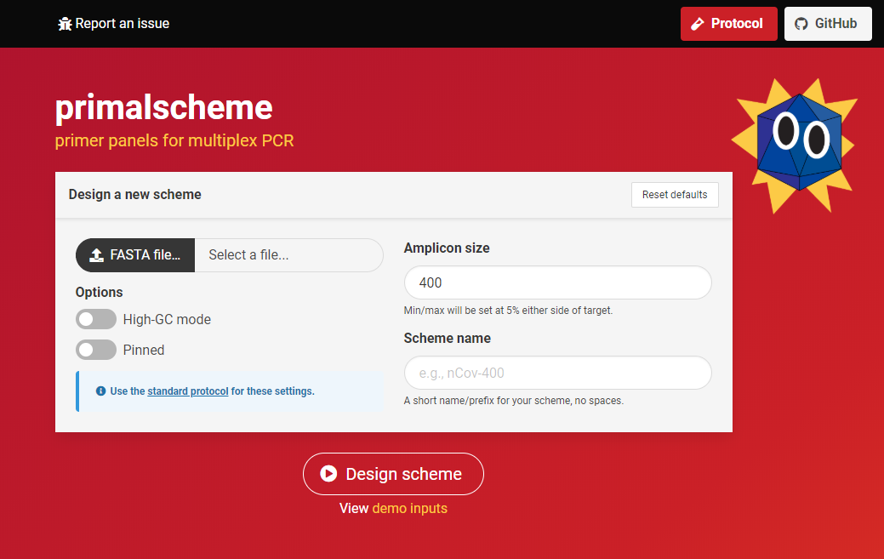
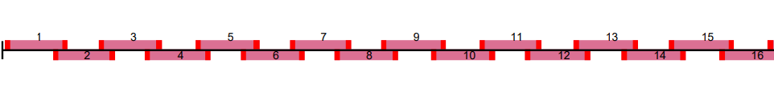
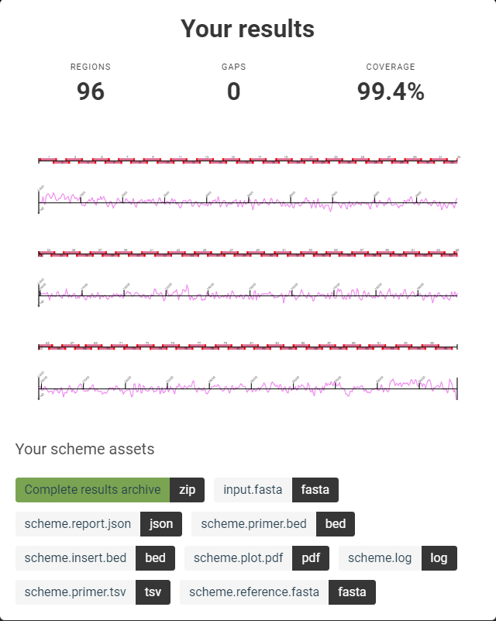
Primal Scheme
https://primalscheme.com/

Slide 7
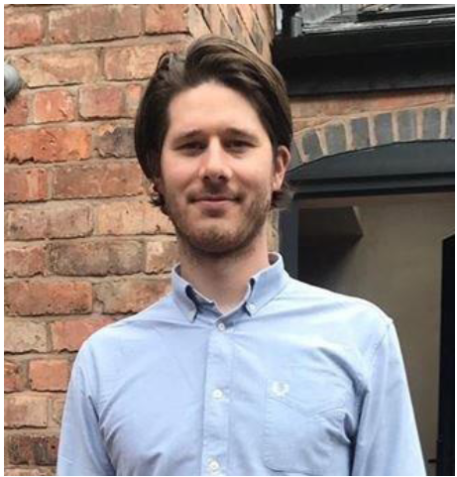
ARTIC nCOV primer scheme
V1 –First introduced in January 2020
V2 –Modifications made to V1 to fix primer-dimers
V3 –Added alternative primers to V2 but was unsuitable for Delta or Omicron
V4 –Entirely new scheme to avoid dropouts common in Alpha, Beta, Delta and Gamma variants
V4.1 –Current release, updated for better functionality of some primers against Omicron
V5 –Time will tell…
Dr Josh Quick
University of Birmingham

Slide 8
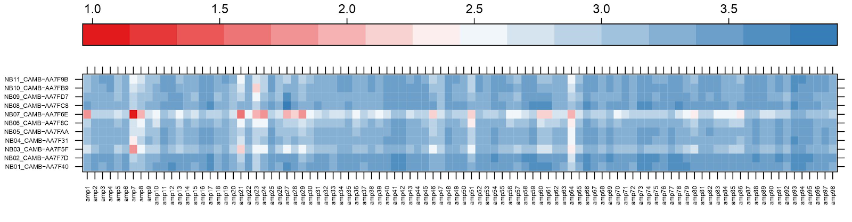
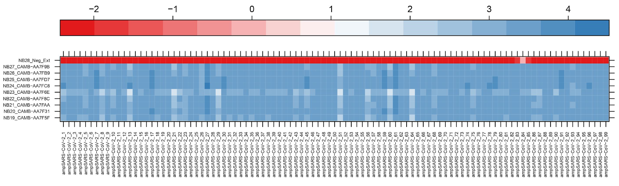
ARTIC nCOV primer scheme
11 Delta samples
Version 3.0
Version 4.0

Slide 9
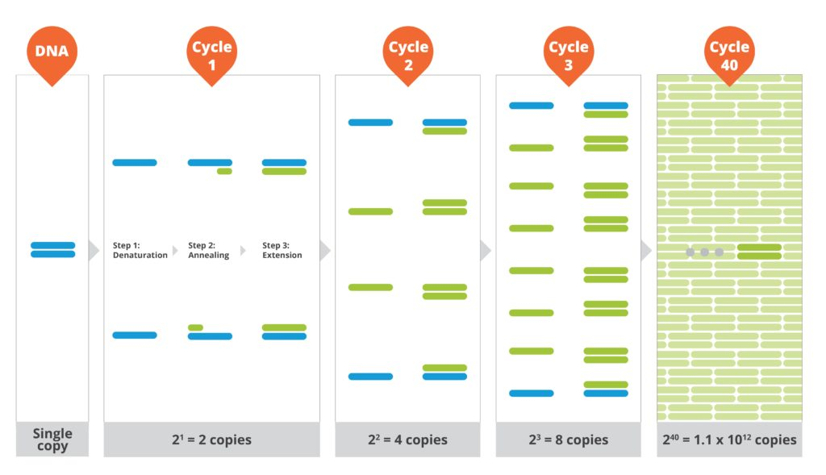
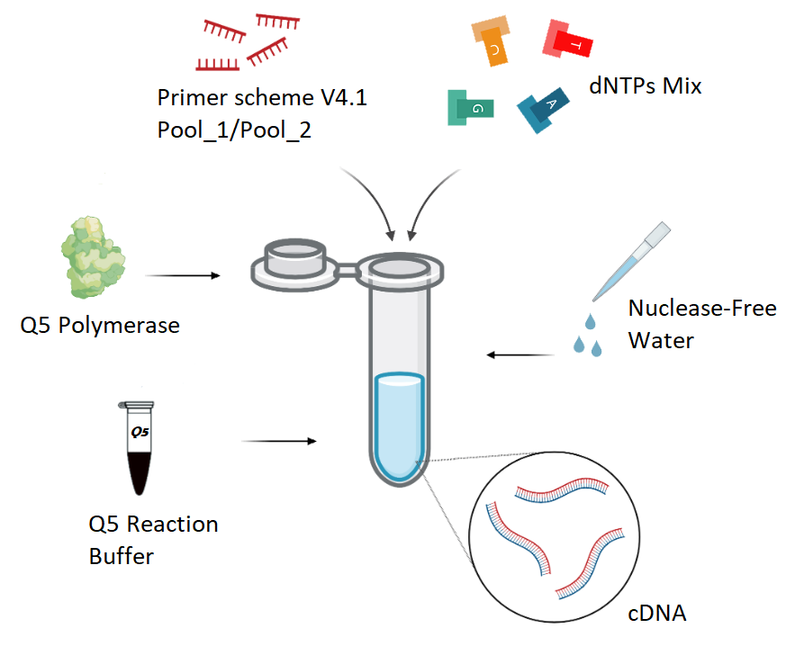
Multiplex PCR
You will need:
Q5 Hot Start DNA Polymerase (NEB)
10X Q5 reaction buffer (NEB)
Primer pools A and B (4.1)
dNTP mix
Nuclease Free Water

Slide 10
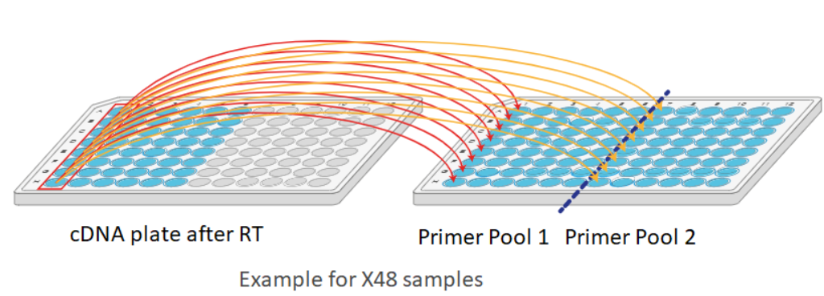
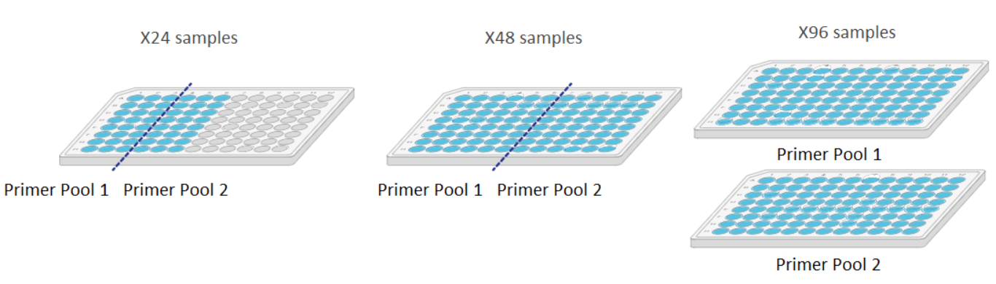
Multiplex PCR
As each sample cDNA is split between two PCR reactions, twice the wells are required
Ensure that the Pool A and Pool B reactions are properly separated and maintain awareness of sample location
High risk of contamination if you’re not careful

Slide 11
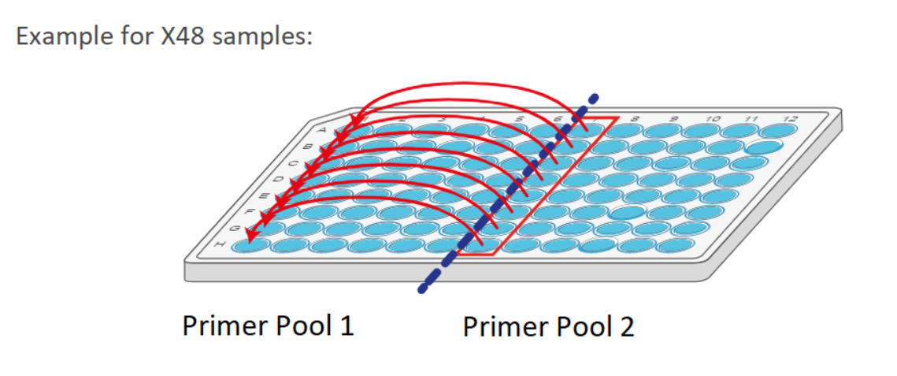
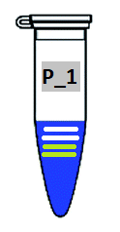
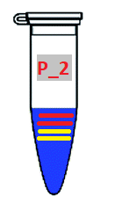

Pooling sample products
Following PCR, Pool A and B products can be combined into a single tube/well for each sample.
Notes:
To new plate or no? Diluting or no?

Slide 12
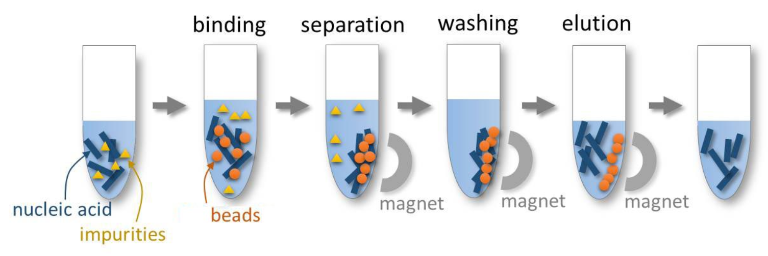
Next step- SPRI
Solid-Phase Reversible Immobilisation
Method used to purify the pooled PCR products of residual salts, enzymes, dNTPs ect
Binds DNA products to magnetically immobilised beads
Unbound materials can then be washed out
Notes:
To new plate or no? Diluting or no?

Slide 13



